Slide 1
ELEMENTARY STATISTICS, BLUMAN
Variance and Standard Deviation of a Grouped Frequency Distribution
© 2019 McGraw-Hill Education. All rights reserved. Authorized only for instructor use in the classroom. No reproduction or further distribution permitted without the prior written consent of McGraw-Hill Education.

Slide 2
Objectives for this PowerPoint
Calculate the sample variance and standard deviation for a grouped frequency distribution.

Slide 3
Procedure
The procedure for finding the variance and standard deviation for grouped data is similar to that for finding the mean for grouped data. The process includes using the midpoints of each class. The class midpoints are used as reliable approximations, since some of the values fall above the midpoint and others fall below.

Slide 4
Grouped Frequency Distribution
Let’s find the variance and standard deviation for this grouped frequency distribution.
We have used this grouped frequency distribution in other PowerPoints.
The data represents the number of electoral votes allocated to each state.
Limits | Boundaries | Frequency
3 to 10 | 2.5 to 10.5 | 34
11 to 18 | 10.5 to 18.5 | 11
19 to 26 | 18.5 to 26.5 | 2
27 to 34 | 26.5 to 34.5 | 2
35 to 42 | 34.5 to 42.5 | 1
43 to 50 | 42.5 to 50.5 | 0
51 to 58 | 50.5 to 58.5 | 1

Slide 5
Starting Table
We need to start with a table with 5 columns with the following headings:
Class
Frequency, f
Midpoint, X_{m}
f*X_{m}
f*X_{m}²
We already have data for the first 2 columns.
Class | Frequency, f | Midpoint, X_{m} | f*X_{m} | f*X_{m}²

Slide 6
Steps to Fill in Table
To find the Midpoint, sum the class endpoints and divide by 2.
To find f*X_{m} multiply the frequency times the midpoint.
To find f*X_{m}² multiply the frequency times the square of the midpoint.
Class | Frequency, f | Midpoint, X_{m} | f*X_{m} | f*X_{m}²
3 to 10 | 34 | (3+10)/2 = 6.5 | 34*6.5 = 221 | 34*6.5² = 1436.5
11 to 18 | 11 | 14.5 | 159.5 | 2312.75
19 to 26 | 2 | 22.5 | 45 | 1012.5
27 to 34 | 2 | 30.5 | 61 | 1860.5
35 to 42 | 1 | 38.5 | 38.5 | 1482.25
43 to 50 | 0 | 46.5 | 0 | 0
51 to 58 | 1 | 54.5 | 54.5 | 2970.25

Slide 7
Sum the 2nd, 4th, and 5th Columns
Next we need to sum the following columns:
Frequency
f*X_{m}
f*X_{m}²

Slide 8
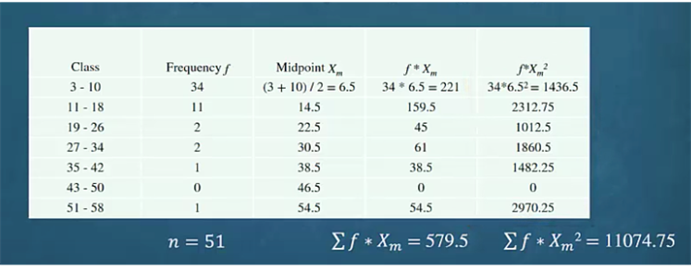
Completed Table

Slide 9

Variance
Each of these sums is then used to evaluate the formula that will provide us with an estimate for the sample variance. Substitute each value appropriately into the formula.
$$s2=\frac{n\left(\sum{f}∗Xm2\right)−\left(\sum{f}∗Xm\right)2}{n(n−1)}$$
$$s2=\frac{51(11074.75)−579.52}{51(51−1)}=89.8$$

Slide 10

Sample Standard Deviation
The square root of the sample variance will give us our estimate for the sample standard deviation.
$$s=\sqrt{89.8}=9.5$$

Slide 11
Discrepancy
The actual standard deviation for the number of members per state is 9.6. Our estimate of the standard deviation using the grouped data was 9.5 members per state.
The discrepancy occurs because in the absence of the raw data, the individual data values for each class were estimated using the midpoints of each class.

Slide 12
Summary
In this PowerPoint we learned how to calculate the sample variance and sample standard deviation for a grouped frequency distribution.

